Slide 1
SOLID Principles

Slide 2
About
Umar Lone
Founder of Poash Technologies [www.poash.com]
Trainer, developer, mentor, consultant
C/C++, STL, Win32 SDK, MFC, COM, ATL, Design Patterns, Linux, Bash Shell Scripting, Core Java, .NET Framework, C#, Android, Objective C, iOS, OOAD, OpenMP
umar.lone@poash.com

Slide 3
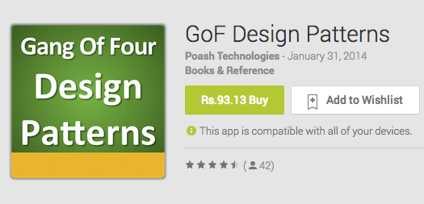
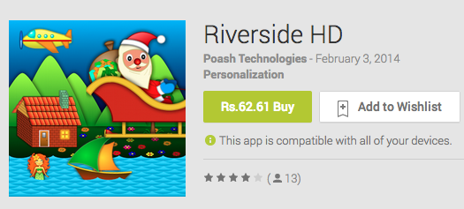
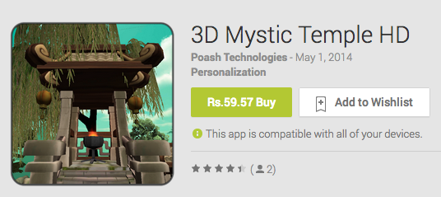
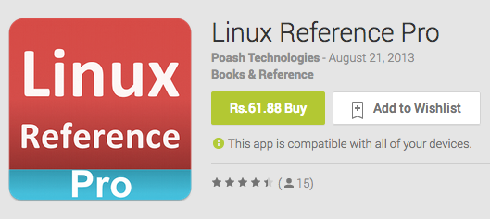
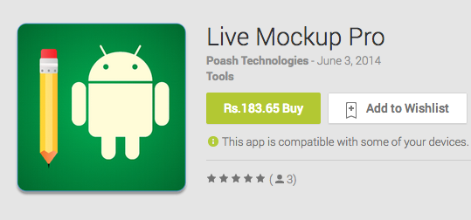
Apps

Slide 4
Principles Of Object Oriented Design
The design patterns are themselves built on the principles of good object oriented design
These are known as the SOLID principles
Following are some of the principles that can be followed while designing an object oriented system
Single Responsibility Principle
The Open Closed Principle
The Liskov Substitution Principle
The Dependency Inversion Principle
The Interface Segregation Principle

Slide 5
Single Responsibility Principle
There should never be more than one reason for a class to change
A class should have only one responsibility
Responsibility is a “reason to change”
because it is implementing some feature
that may require a change afterwards (due to client requirement, updates, etc.)

Slide 6
Multiple Responsibilities
Unmaintainable class
Difficult to change
Breaks when one responsibility is modified
Unnecessary dependencies on unrelated classes

Slide 7
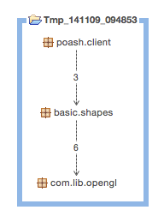
Dependencies
Changing the rendering library will also affect the client, although it doesn’t use it

Slide 8
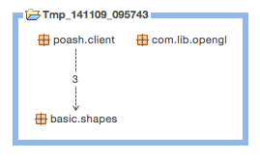
Refactored

Slide 9
Applying SRP
Identify the context in which the class has to be used
Separate out responsibilities in different classes (based on the context)
Remove unnecessary dependencies

Slide 10
The Open Closed Principle
A module should be open for extension but closed for modification
Most important design principle
Modules implementing OCP have two attributes
open for extension and their behavior can be changed through extension.
closed for modification. Extending the behavior of the module does not result in a change to the source or the binary of the module

Slide 11
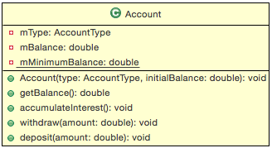

Example

Slide 12
Issues
Not easy to add new features
Adding a new account will cause a cascade of changes in the class
Other classes that use Account class will also change
Each change may introduce bugs and require re-testing, re-deployment
Not object-oriented!!!

Slide 13
Implementing OCP
Look for OO approach
Using enums for behaviour through conditionals can be converted to classes
May extend a common base class

Slide 14
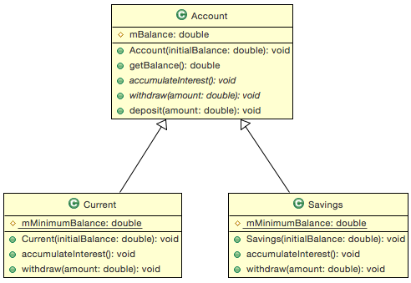
Refactored

Slide 15
Advantages
Simplified extension
Loose coupling
Less dependencies
Maintainability

Slide 16
Liskov Substitution Principle
Subtypes must be substitutable for their base types
Devised by Barbara Liskov in her work regarding data abstraction in 1988
A user of a base class should continue to function properly if a derivative of that base class is passed to it

Slide 17
Substitutability
Child classes
should not require calling code to know they are different from their base type
must not remove parent class behaviour
Clients make assumptions based on the base class and won’t know about the derived types

Slide 18
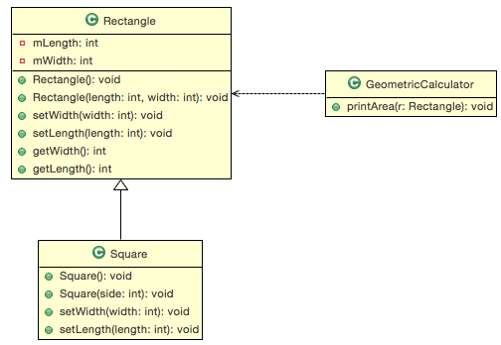
Is-a Relationship

Slide 19
Issues
Square may be a type of Rectangle, but a Square object cannot substitute a Rectangle object
We have to change behaviour of base class to make Square work
Unnecessary patching required in Square
Unnecessary fields in Square

Slide 20
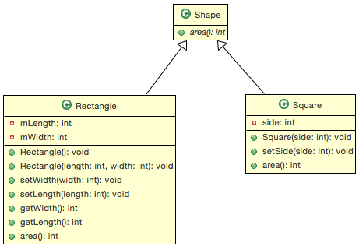
Refactored

Slide 21
Advantages
OCP is at the heart of object oriented design
LSP is an important feature of all programs that conform to it
When derived types are completely substitutable for their base types, extension is easy
Existing code will work without any changes with the future subclasses

Slide 22
Dependency Inversion Principle
Program to an interface, not an implementation
The powerful interpretation of DIP is simple: “Depend upon abstractions”.
no variable should hold a reference to a concrete class
no class should derive from a concrete class
DIP states the primary mechanism, if OCP states the goal of OO architecture
Abstractions serve as “hinge points” where the design can be bent or extended without themselves being modified

Slide 23
Example
class Controller
{
Furnace m_fn ;
Thermometer m_thm ;
public void Regulate()
{
float temp = m_thm.GetTemperature() ;
if(temp < MINTEMP)
m_fn.Increase() ;
else if(temp > MAXTEMP)
m_fn.Decrease() ;
}
Controller
Thermometer
Furnace
Notes:
Consider an application that regulates the temperature of a furnace
The regulator reads the temperature from the thermometer & regulates the temperature of the furnace

Slide 24
Discussion
The high level modules contain the important policy decisions and business models of an application and represent the identity of the application
If such high level modules depend on low level modules, then any change to the low level modules will cause the high level modules to change
This dependency needs to be inverted so that the low level modules are dependent on the high level modules

Slide 25
Applying DIP
This is how the application looks after applying DIP
Regulator can now be used with any kind of sensor & heater
The low level modules (Thermometer, Furnace) are now dependent on high level module (Controller)
The dependency has been inverted
Controller
Sensor
Device
Thermometer
Furnace

Slide 26
Interface Segregation Principle
Clients should not be forced to depend on methods they do not use
This principle deals with the disadvantages of fat interfaces
It suggests that interfaces can be broken up into groups of functions and each group will serve a different set of clients
Easier to manage the interfaces in case of a change

Slide 27
Example
This design follows OCP, LSP & DIP
clients use the classes through an interface
a function taking IFile reference will still work if passed a TextFile or StreamFile object
More classes can be added without breaking the code
<<interface>>
IFile
Open
Close
Read
Write
Seek
Tell
Size
TextFile
StreamFile

Slide 28
Case Study
The programmer now wants to add support for sockets and pipes
He creates two classes called as Socket & Pipe and inherits them from the IFile interface
But what would the implementation of Seek(), Tell() & Size() be for these classes? These functions are useless for sockets and pipes
One solution is implement the functions and throw a NotSupportedException if these are called from the client code

Slide 29
File I/O Library
<<interface>>
IFile
Open
Close
Read
Write
Seek
Tell
Size
What about these functions?
TextFile
StreamFile
Socket
Pipe

Slide 30
Discussion
ReadData() will work fine as long as a TextFile or StreamFile pointers are passed to it
But it would fail if a Socket or Pipe pointer is passed to it
violates LSP
The client is not wrong in assuming the correctness of GetSize() method for derivatives of IFile. It is the IFile interface that is violating its part of the contract
It contains functions which are not applicable to all of its derived classes.
Such interface is called as a fat interface because this interface contains methods which are not useful to some of its clients
void ReadData(IFile *pFile)
{
long size = pFile->GetSize() ;
char *ptr = new char[size] ;
…
}

Slide 31
Applying ISP
Application of this principle leads to interfaces that are clean, small and easily maintainable
Such interfaces do not violate any of the OO principles and lead to a better design
<<interface>>
IFile
<<interface>>
IDiskFile
Open
Close
Read
Write
Seek
Tell
Size
TextFile
StreamFile
Socket
Pipe

Slide 32
Assignment
Draw relationships between the following entities. Modify as appropriate. Anticipate future changes.
Button
Lamp
A button is used to turn a lamp on or off
Audio player plays MP3 audio format
Audio Player
MP3
Process
Thread
A process is using a thread
Notes:
There are several problems:
Button directly depends on lamp
Any change in lamp will effect the button
Button cannot be reused with any other application

Slide 33
Assignment
Draw relationships between the following entities. Modify as appropriate. Anticipate future changes.
Driver
Car
Driver drives a car
HDD
Files
Hard drive contains files
Notes:
There are several problems:
Button directly depends on lamp
Any change in lamp will effect the button
Button cannot be reused with any other application

Slide 34
Assignment
Draw relationships between the following entities. Modify as appropriate. Anticipate future changes.
Rectangle
array<T>
Window
stack<T>
A Window needs a Rectangle (for geometric calculations)
Reuse array<T> in a stack<T> for storage
Notes:
The first case violates ISP.
Use containment in the second case.

